Slide 1
Software Testing
Specification-Based Unit, Decision Table-Based Testing
Presented By
Ning Chen, Ph.D.
Professor
Department of Computer
Science
California State University,
Fullerton
© Ning Chen, 2017
*

Slide 2
Module Objectives
This module focuses on the Specification-Based Unit, Decision Table-Based Testing

Slide 3
Name
Specification-Based Unit, Decision Table-Based Testing
Is it restricted to unit testing only
  No.
  Nevertheless, in this module, we only focus on the unit testing.

Slide 4
An Observation
Sometimes it is easier to learn something starting from an observation.

Slide 5
An ATM example
A customer requests a cash withdrawal. One of the business rules for the ATM is that the ATM machine pays out the amount if the customer has sufficient funds in their account or if the customer has the credit granted. Already, this simple example of a business rule is quite complicated to describe in text.

Slide 6
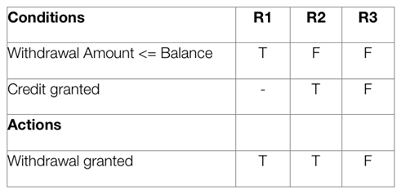
Decision Table
A decision table makes the same requirements clearer to understand:

Slide 7
Continue…
In a decision table, conditions are usually expressed as true (T) or false (F). Each column in the table corresponds to a rule in the business logic (and therefore the column’s names, R1, R2…) that describes the unique combination of circumstances that will result in the actions. The table above contains three different business rules, and one of them is the “withdrawal is granted if the requested amount is covered by the balance①.” It is normal to create at least one test case per column, which results in full coverage of all business rules.

Slide 8
Continue…
One advantage of using decision tables is that they make it possible to detect combinations of conditions that would otherwise not have been found and therefore not tested or developed. The requirements become much clearer and you often realize that some requirements are illogical, something that is hard to see when the requirements are only expressed in text.

Slide 9
Continue…
A disadvantage of the technique is that a decision table is not equivalent to complete test cases containing step-by-step instructions of what to do in what order. When this level of detail is required, the decision table has to be further detailed into test cases.

Slide 10
Continue…
① Actually, this business rule statement ends up with two rules. The first one is “withdrawal is granted if the requested is covered by the balance and the customer has the credit granted.” The second rule is “withdrawal is granted if the requested is covered by the balance and the customer has the credit not granted.” For convenience, since the second condition “the customer has the credit granted” is a “don’t care” case, we can simple combine two rules into one “withdrawal is granted if the requested is covered by the balance.” The don’t care is represented by a dash line “-“ in the table.

Slide 11
Another Example
E-Commerce application

Slide 12
Website of handling credit cards
Possible questions/inputs
  Is the account real?
  Is the account active?
  Is the amount request within credit limit?
  Is the consumer spending location okay?

Slide 13
Continue…
Possible outcomes
  the charging request is approved.
  need to call cardholder (to verify)
  need to call vendor (maybe to get more information or call policy)

Slide 14
How many business rules?
4 inputs -> 16 combinations
Does number of actions affect the number of combinations?

Slide 15
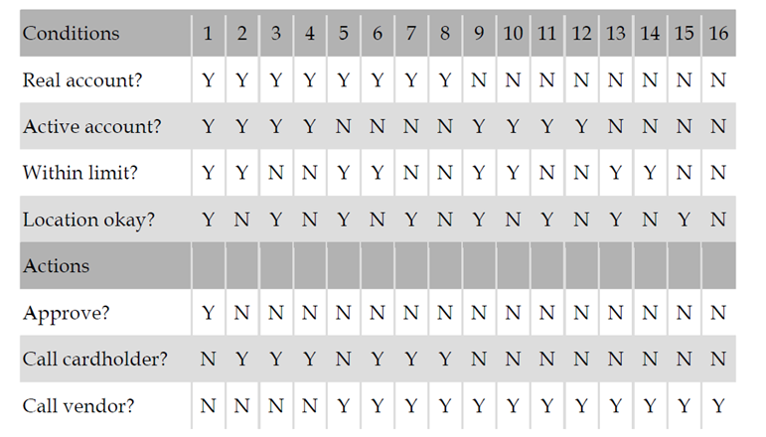
Decision Table

Slide 16
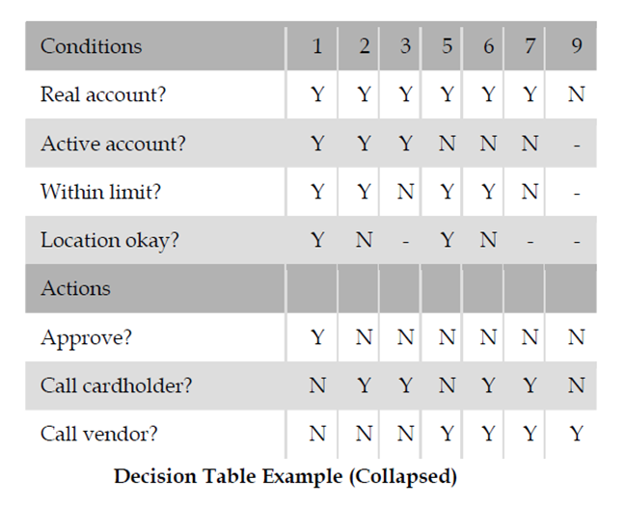
Collapsing columns

